Slide 1

CS6120 – Natural Language Processing Project
Automated Peer Review
From Structure to Substance, an end-to-end evaluation for research papers
15 April, 2025

Slide 2
Group 4 - Team Members
Manoghn Kandiraju
Sanjiv Motilal Choudhari
Snigdha Mohana Addepalli
Sai Manichandana Devi Thumati

Slide 3
Introduction
Our project aims to automate the critique and evaluation of research papers using advanced NLP techniques and large language models (LLMs).
Recognizing the growing volume of academic publications, we strive to develop a system that can assist in comprehensively reviewing the research paper, thereby streamlining the peer-review process and enhancing the quality of academic research

Slide 4
Background & Related Work
Current scenario:
The peer-review process remains manual, subjective and time-consuming.
PeerRead has enabled datasets to model the reviewer feedback
BART and FLAN-T5 are effective for tasks like summarizing and instruction-based generation
The previous work has been more focused on the rhetorical role labeling, sentiment tagging and reviewer simulation- but has lacked a comprehensive integration
Our work intends to build these individual features and make a unified critique system to evaluate a research paper using concepts of NLP and LLMs

Slide 5



Project Objectives
Analysis
Strategy
Implementation
Automate the review process of academic papers using LLMs to reduce manual effort and improve the consistency and efficiency
Provide meaningful section wise summary and suggestion to enhance the quality of the research writing
Identify and flag biased and plagiarized content to promote fairness and originality in the academic work

Slide 6

Resources utilized
Datasets:
Models
ArXiv Papers
PeerRead dataset
Fine-tuned Mistral (critique)
BART (summarizing)
Flan-T5
MiniLM(Plagiarism via embeddings)
VADER (Bias detection)

Slide 7
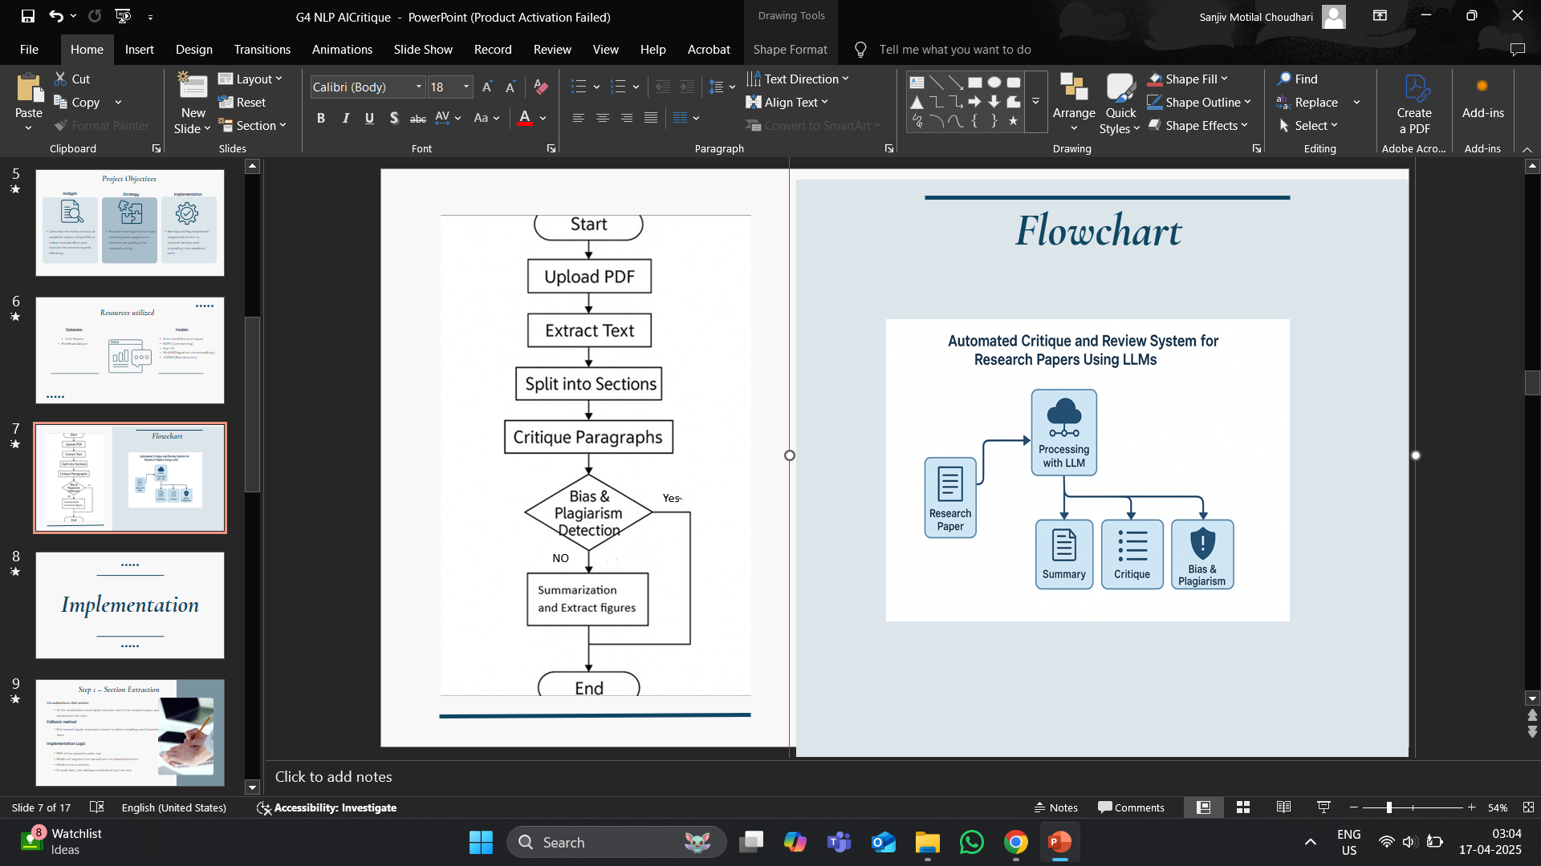
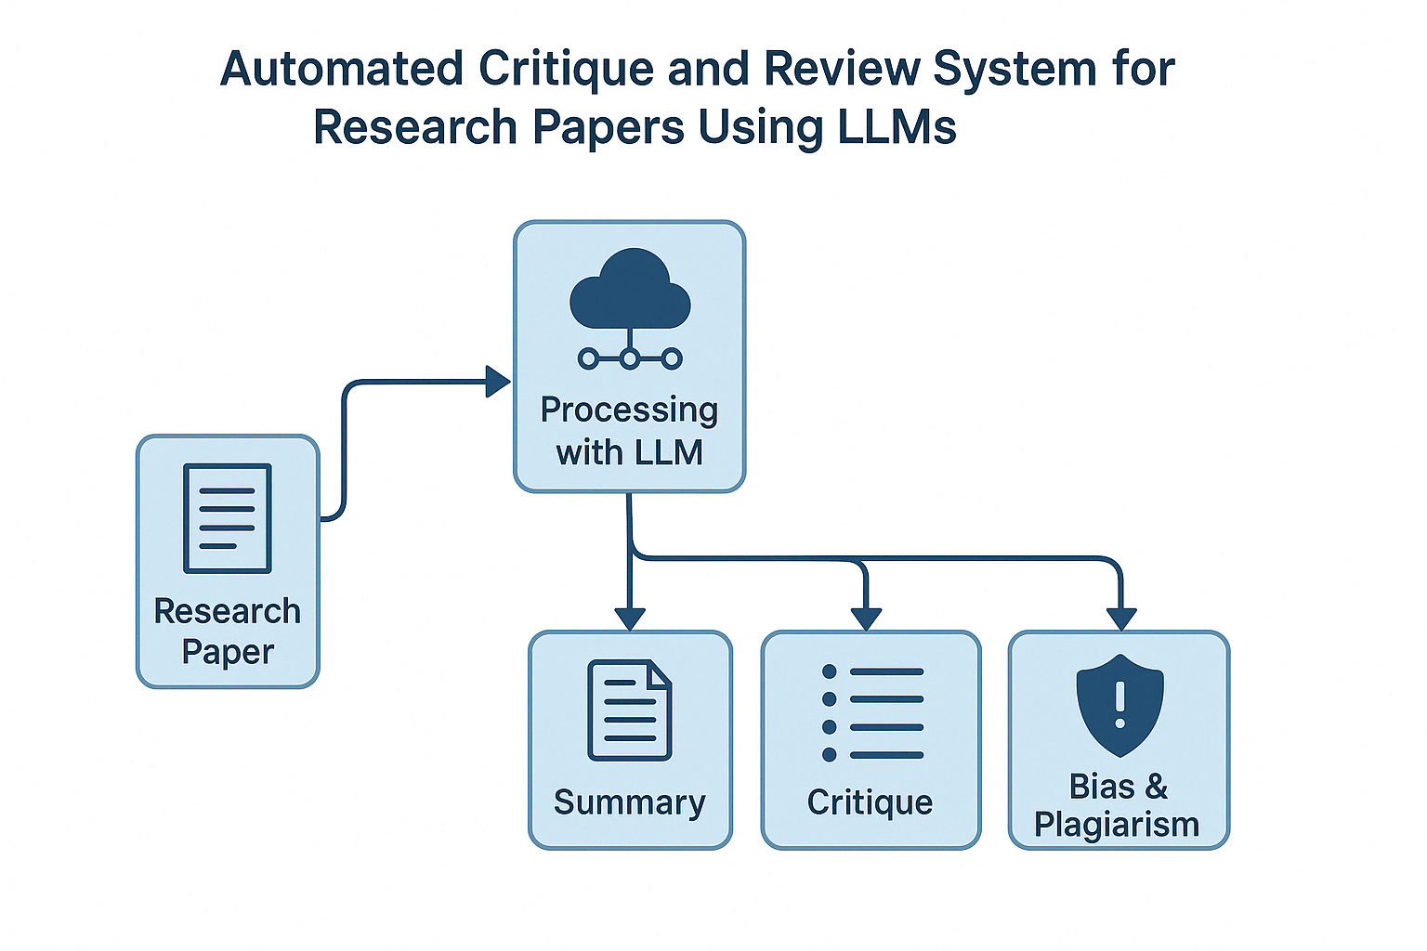

Flowchart

Slide 8
Implementation

Slide 9

Step 1 – Section Extraction
Visualizations Extraction
All the visualizations and tables that are vital to the research paper are extracted in this step.
Fallback method
Rule based regular expression parser to detect headings and separate them
Implementation Logic
PDF will be parsed to plain text
Model will segment the parsed text into labelled sections
Model returns sections
If model fails, then fallback method will split the text.

Slide 10
Step 2 – Summarization
Model Used
Facebook/bart-large-cnn (transformer model fine tuned to summarize)
Process Flow
Each section is now passed to BART
Input is tokenized and truncated to fit the token limit of the model
BART outputs summary
Impact
Captures high level essence without loss in technicality of terms
Enables quick comprehension of paper sections
Useful for fast first-pass understanding
Preserves the structure

Slide 11
Step 3 – Critique
Model Used
Mistral-qlora-critique (fine tuned Mistral 7B model) hosted on Hugging face specific for academic critique
Functionality
Model generates bullet points for paragraphs as critique
Critiques on clarity, structure, reasoning, and depth
Suggests actionable writing improvements
Impact
High-quality, structured feedback for content in academic papers
Mimics peer-review tone
Elevates system from shallow grammatical suggestions to contextual academic critique

Slide 12
Step 4 – Plagiarism and Bias
Bias and Plagiarism
Bias Detection
- Used VADER for sentiment scoring of each paragraph
- Printed the flagged paragraphs for extreme tone/polarity
Plagiarism Check
- Used MiniLM embeddings approach to check the plagiarism
- Compared cosine similarity with PeerRead reviews
- Printed the paragraphs with flagged score > 0.5 as ‘plagiarized’

Slide 13
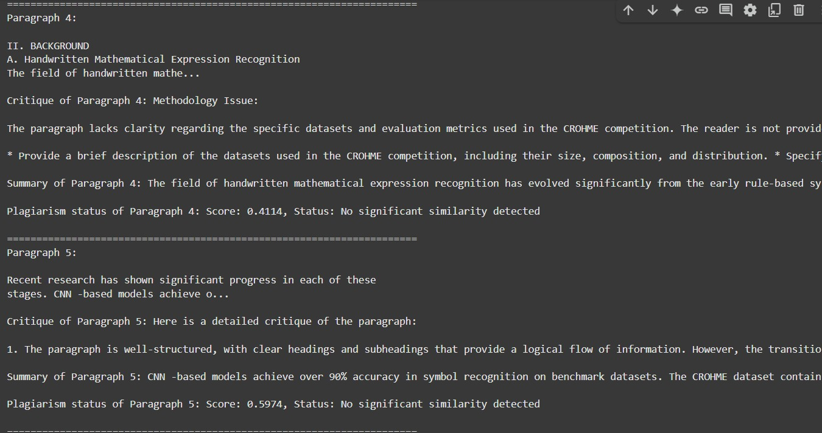
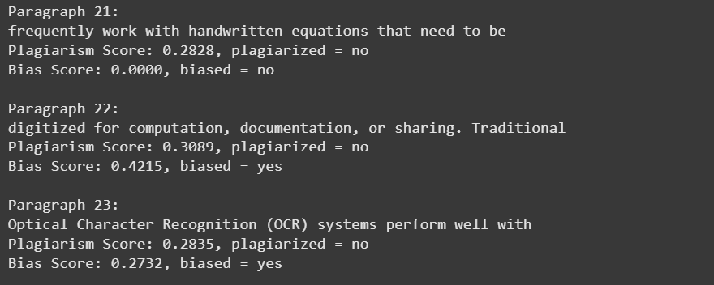
Results
Provides the critique to each paragraph
Summarizes each paragraph
Provides the plagiarism and bias scores
Prints the part of the content that is
flagged for either bias or plagiarism

Slide 14
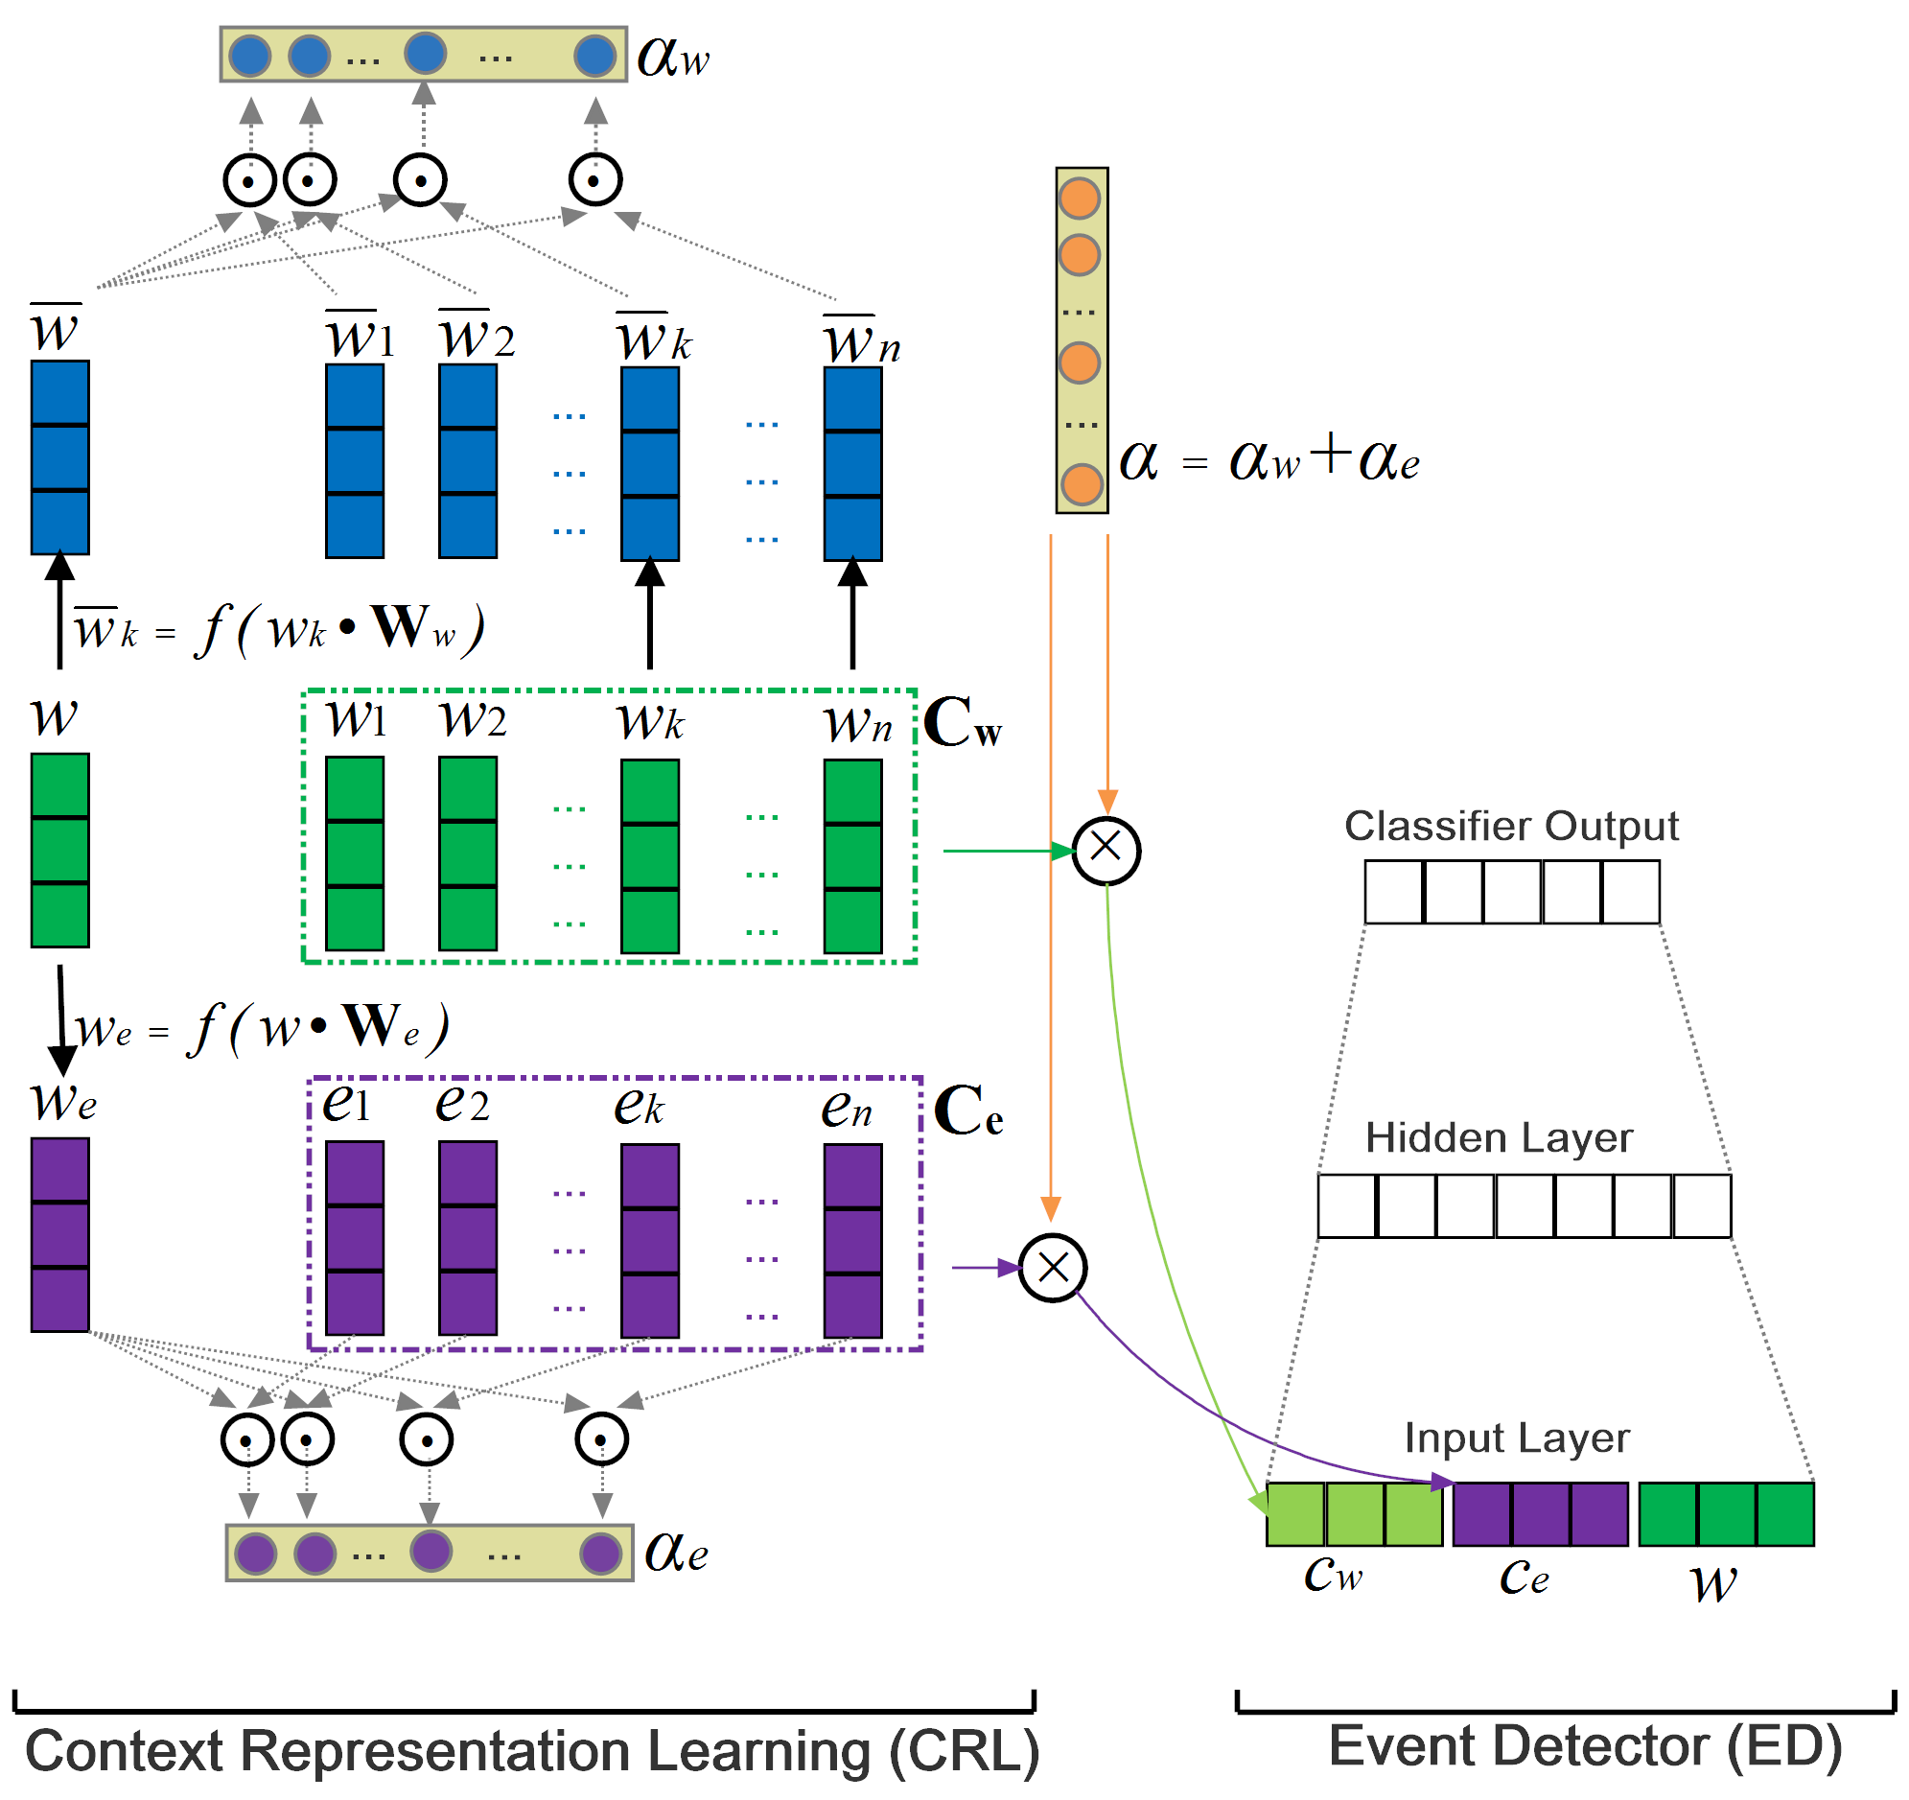
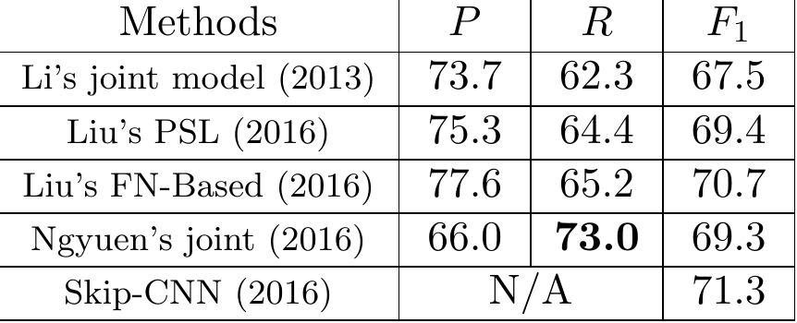
Results
Flowchart extracted from a sample paper
Table extracted from a sample paper

Slide 15
Takeaways
Challenges Extensions
Hallucinations and Vague Critiques
Parsing into sections
Plagiarism is limited to semantic similarity
Heavy reliance on fine-tuned LLM for critique quality
Academic tone has less polarity resulting in constant bias 0 scores
Not all papers were responsive to the visualizations extraction method
Unified model for all tasks (streamlined)
Interactive Web Interface to gain insights into the paper
Expansion of plagiarism corpus
Domain-specific fine tuning to improve relevance
Evaluation and analysis of figures and tables in the research paper

Slide 16
Conclusion
Developed an end-to-end automated critique system for academic research papers.
Combined PDF parsing, section summarization, critique, bias and plagiarism detection
Integrated a fine-tuned Mistral LLM for generating peer-review
Used real abstracts from PeerRead as a reference Corpus for semantic plagiarism checking
Figures that have been extracted were partially upto the mark.

Slide 17
Thank you

